Slide 1

IBM CONCERT PLATFORM · MODULE 5
From the IBM Concert Platform to the Products Behind It
The platform brings together distinct components, each supported by IBM products and capabilities. This module connects the platform story to individual products and leads into product-specific L2 learning.
Platform Story
Concert Components
IBM Products
Product L2 Learning
Use this mental model to navigate between the broader Concert platform narrative and the familiar IBM products sellers already know — including IBM Instana, IBM Cloud Pak for AIOps, and IBM Turbonomic.
Notes:
In the previous module, we learned how to tell the IBM Concert platform story to customers. That story is intentionally broader than any single product.
At the same time, many of you already know IBM through individual products such as IBM Instana, IBM Cloud Pak for AIOps, and IBM Turbonomic. As IBM Concert has evolved into a platform, those product capabilities are now organized and presented through Concert components such as Observe, Operate, Optimize, Protect, Resilience, and Workflows.
This module connects those two views. We’ll start with the six IBM Concert platform components, connect them to the products and capabilities behind them, and then spend a little more time on what each component is designed to do.
The goal is not to reteach each product. It’s to give you a simple mental model for understanding how the portfolio fits together within the broader IBM Concert platform.

Slide 2
IBM Concert platform Components
Each component addresses a distinct operational priority within the broader platform.
Observe
Operate
Understand application, infrastructure, network, and user-experience health
Correlate operational signals and help teams manage incidents
Optimize
Protect
Continuously balance application performance, resource utilization, and cost
Identify, prioritize, and remediate risk across the software lifecycle
Resilience
Workflows
Assess and improve application and operational resilience
Coordinate and automate actions across teams and tools
Notes:
Before we look at the products behind each component, let’s briefly recap the six areas that make up the IBM Concert platform.
Observe helps teams understand application, infrastructure, network, user-experience, and AI health.
Operate focuses on bringing operational signals together, correlating issues, and helping teams manage incidents across complex environments.
Optimize continuously balances application performance with infrastructure utilization and cost.
Protect helps organizations identify, prioritize, and remediate risk across the software lifecycle.
Resilience helps teams assess and strengthen application and operational resilience.
And Workflows provides the orchestration layer for coordinating and automating actions across teams and tools.
Each component addresses a different operational priority, but they are designed to work within the same broader IBM Concert operating model rather than as isolated silos.

Slide 3
How IBM Concert Components Map to IBM Products
These six components map to IBM products and offerings that sellers may already know. The underlying products retain their individual capabilities and product-specific L2 learning paths, while IBM Concert provides the broader platform context that connects them.
IBM Concert Component | IBM Product(s)
Observe | IBM Instana; IBM Concert Network Observability
Operate | IBM Cloud Pak for AIOps
Optimize | IBM Turbonomic
Protect | IBM Concert Protect
Resilience | IBM Concert Resilience
Workflows | IBM Concert Workflows
Notes:
These components also map to IBM products and offerings that many of you may already know.
Observe includes IBM Instana and IBM Concert Network Observability.
Operate maps to IBM Cloud Pak for AIOps.
Optimize maps to IBM Turbonomic.
Protect, Resilience, and Workflows map to their corresponding IBM Concert offerings.
The important thing to remember is that the platform does not erase the identity or depth of these products. They continue to provide specialized capabilities and, where applicable, their own Level 2 learning paths.
IBM Concert gives sellers the broader context for understanding how those capabilities fit together as part of one platform story.
Now that we have that map, let’s look at each component in a little more detail.

Slide 4
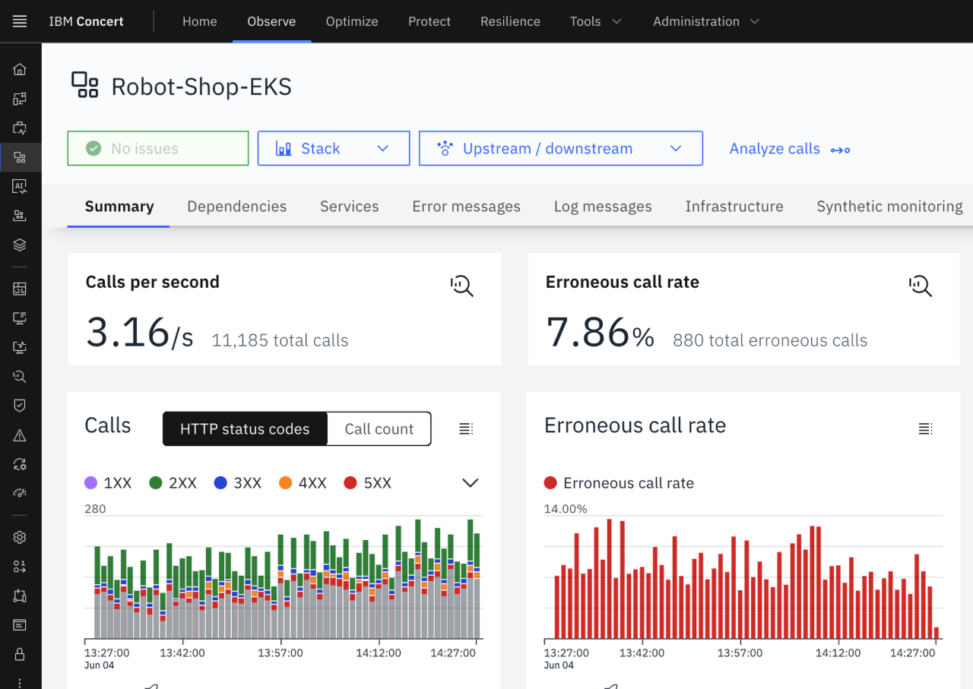
IBM Concert Observe
Full-stack observability to detect issues and improve reliability
Features
Full-stack application observability
SevOne/CNO capabilities available via SaaS (on Roadmap)
AI agent and LLM observability
Synthetic monitoring
Infrastructure observability
50%
70%
65%
Reduction in MTTD
Reduction in MTTR
Reduction in incident response time
Notes:
Let’s start with Concert Observe.
Today, teams often monitor applications, infrastructure, networks, user journeys, and AI systems through different tools and views. The challenge is not simply seeing each layer — it is understanding how those layers depend on one another when something goes wrong.
Concert Observe brings those signals together to provide full-stack observability across applications, infrastructure, networks, user experiences, and increasingly AI-powered applications.
Its capabilities include full-stack application and infrastructure observability, synthetic monitoring, AI agent and LLM observability, and network observability through IBM Concert Network Observability.
By connecting those layers, Observe helps teams understand what is happening across the service, narrow the likely cause, and reduce the time spent moving between tools and teams during investigation.
Consider Observe when customers are dealing with observability gaps, slow investigation, fragmented application and network visibility, or the challenge of maintaining reliable applications and AI services as their environments become more complex.

Slide 5
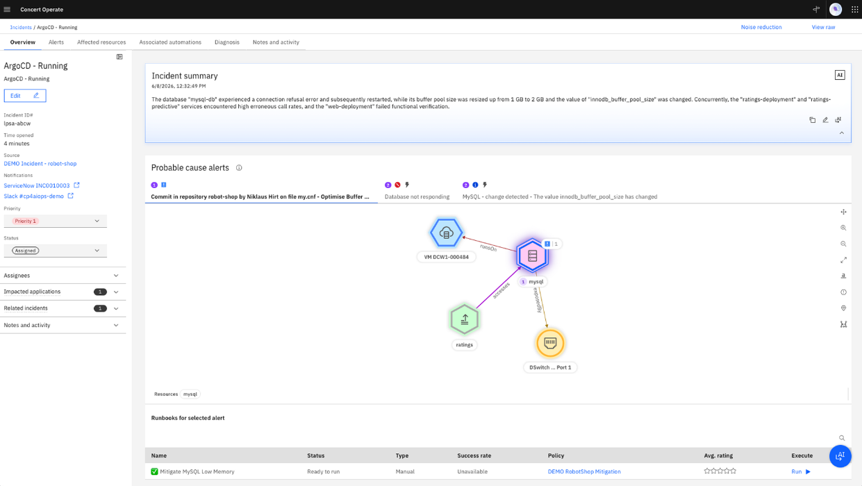
IBM Concert Operate
Unified operations. Faster response.
Features
Ingest, correlate, and manage events across tools and environments
Detect and identify cascading failures and probable root causes across dependencies
Unify detection driven by agentic AI
160+
50%
15%
Out of the box integrations
Fewer incidents
Less unplanned downtime
Notes:
Concert Operate is focused on helping IT operations teams manage the growing volume and complexity of events and incidents across their environments.
Operate brings together events from multiple tools and environments, correlates related signals, and helps teams understand when individual alerts are actually part of the same broader problem.
It can also help identify cascading failures and probable root causes across dependencies, so operations teams spend less time manually sorting through noise and more time focusing on what requires action.
Agentic AI builds on that foundation by helping teams unify detection, investigation, and response across the operational environment.
Consider Operate when customers describe alert overload, fragmented event management, lengthy bridge calls, or difficulty coordinating incident response.
The underlying product foundation here is IBM Cloud Pak for AIOps.

Slide 6
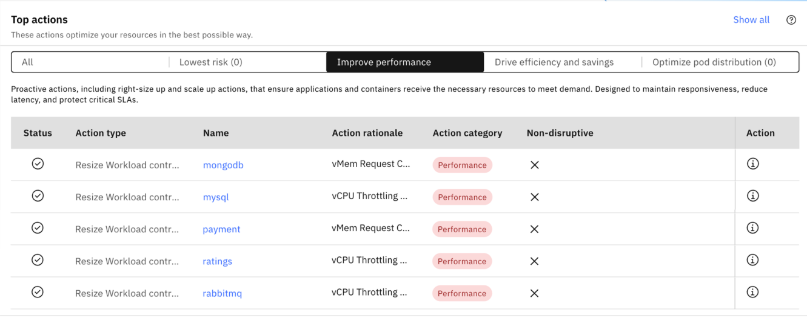
IBM Concert Optimize
Optimized resources, smarter decisions
Features
Performance assured actions; automate to unlock elasticity
Data center optimization
Kubernetes optimization
Cloud performance optimization
AI workload optimization
Plan capacity and migration
247%
35%
30%
ROI
Cloud investment improvement
Engineering time back
Notes:
Concert Optimize focuses on continuously balancing application performance, infrastructure capacity, and cost.
Rather than waiting for a performance problem or manually reviewing utilization after the fact, Optimize analyzes demand and resources across the environment and identifies where action is needed.
That can include data center optimization, Kubernetes optimization, public cloud optimization, AI workload optimization, and planning for capacity or migration decisions.
The goal is not simply to cut infrastructure. It is to make sure applications receive the resources they need while avoiding unnecessary overprovisioning and making better use of the capacity the organization already owns or pays for.
Optimize can recommend actions such as rightsizing, scaling, or placement, and those actions can be carried out with the level of automation and governance the organization chooses.
Consider Optimize when customers are struggling with rising infrastructure costs, wasted capacity, application performance risk, Kubernetes efficiency, or AI and GPU resource pressure.
IBM Turbonomic provides the core optimization capabilities behind Concert Optimize.

Slide 7
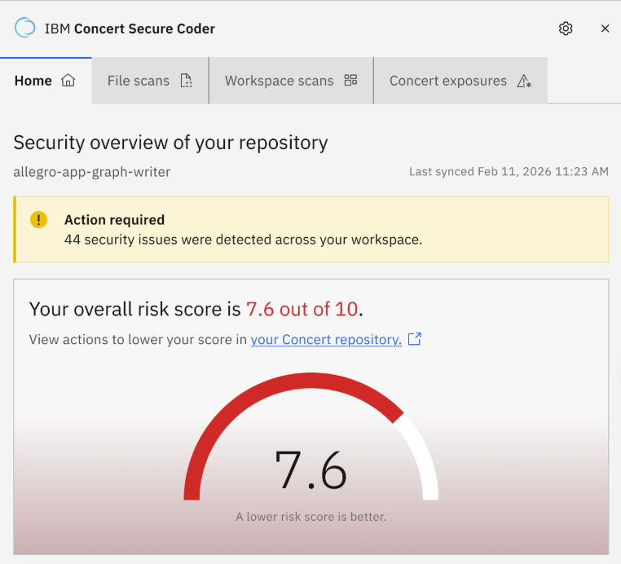
IBM Concert Protect
IBM Concert Protect
Identify, prioritize, and fix exposures across your entire SDLC
Features
See risk across your full estate
Prioritize what matters with AI-driven, business-aware risk scoring
Understand real blast radius by correlating exposures across layers
Fix vulnerabilities in-code, at the point of creation with Secure Coder
78%
20,00 hrs
10x
Patching cost reduction
Saved annually
Faster vulnerability fixes
Notes:
Concert Protect helps organizations understand, prioritize, and remediate risk across the software lifecycle.
One of the biggest challenges security teams face is not simply finding vulnerabilities. It is determining which findings actually matter and where limited remediation resources should be focused first.
Protect brings together security findings with application, code, infrastructure, runtime, and business context to create a more complete understanding of exposure.
It then helps teams prioritize based on factors such as exploitability and business impact, rather than relying on severity scores alone.
Protect also extends remediation across the lifecycle. With Secure Coder, developers can address issues earlier in the IDE, while automated patching and other remediation capabilities help operations teams address exposures in production.
Consider Protect when customers are dealing with vulnerability backlogs, manual triage, patching effort, disconnected security tools, or the need to shift security earlier into development.
The broader goal is to reduce the time between identifying risk and actually resolving the exposures that matter most.

Slide 8
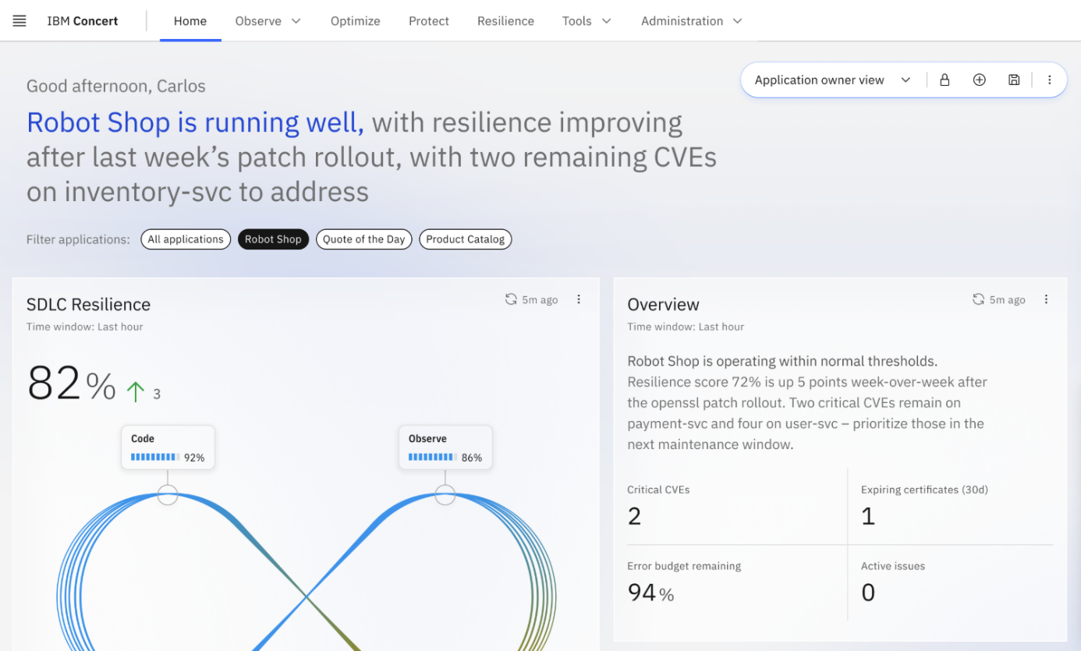
IBM Concert Resilience
From fragmented signals to unified resilience
Features
Collect and score siloed organizational data
Identify resilience weaknesses before they impact availability
Align teams around shared resilience priorities
Standardize and continuously measure resilience posture over time
60%
90%
62%
Organizations hit by outages
Enterprises losing $300K+/hr
Faster resilience assessments with unified posture scoring
Notes:
Concert Resilience helps organizations understand and continuously improve how prepared they are to withstand operational disruption.
Resilience information is often scattered across teams, assessments, documents, and operational systems. That makes it difficult to establish a consistent view of resilience posture or agree on which weaknesses should be addressed first.
Concert Resilience brings that information together so organizations can identify weaknesses before they affect availability, align teams around common resilience priorities, and measure their posture consistently over time.
It also helps standardize resilience assessments across teams, making it easier to compare results, track progress, and move from periodic exercises toward continuous resilience management.
Consider Resilience when customers are concerned about outages, business continuity, inconsistent resilience assessments, or difficulty coordinating resilience responsibilities.
The objective is not simply to produce another resilience score. It is to turn that assessment into a more consistent and actionable way of improving operational readiness.

Slide 9

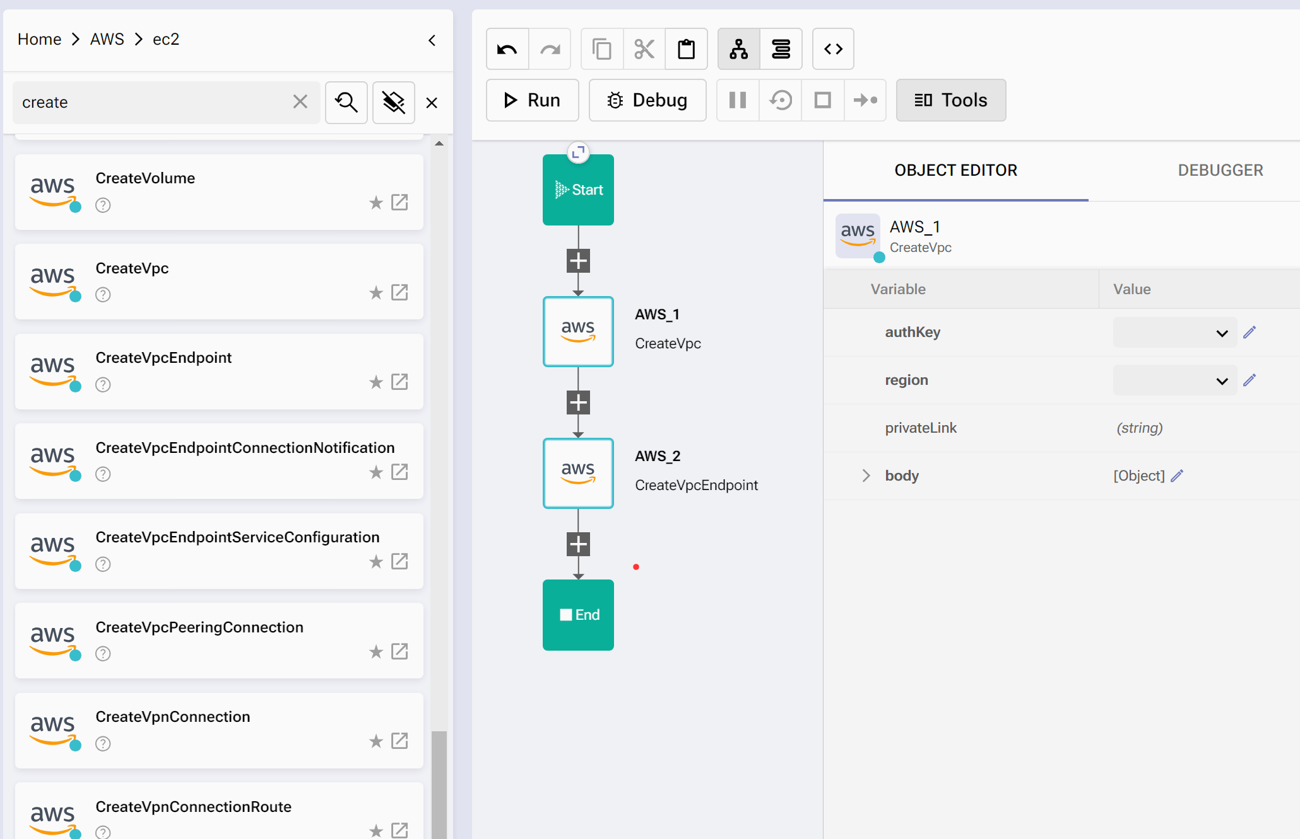
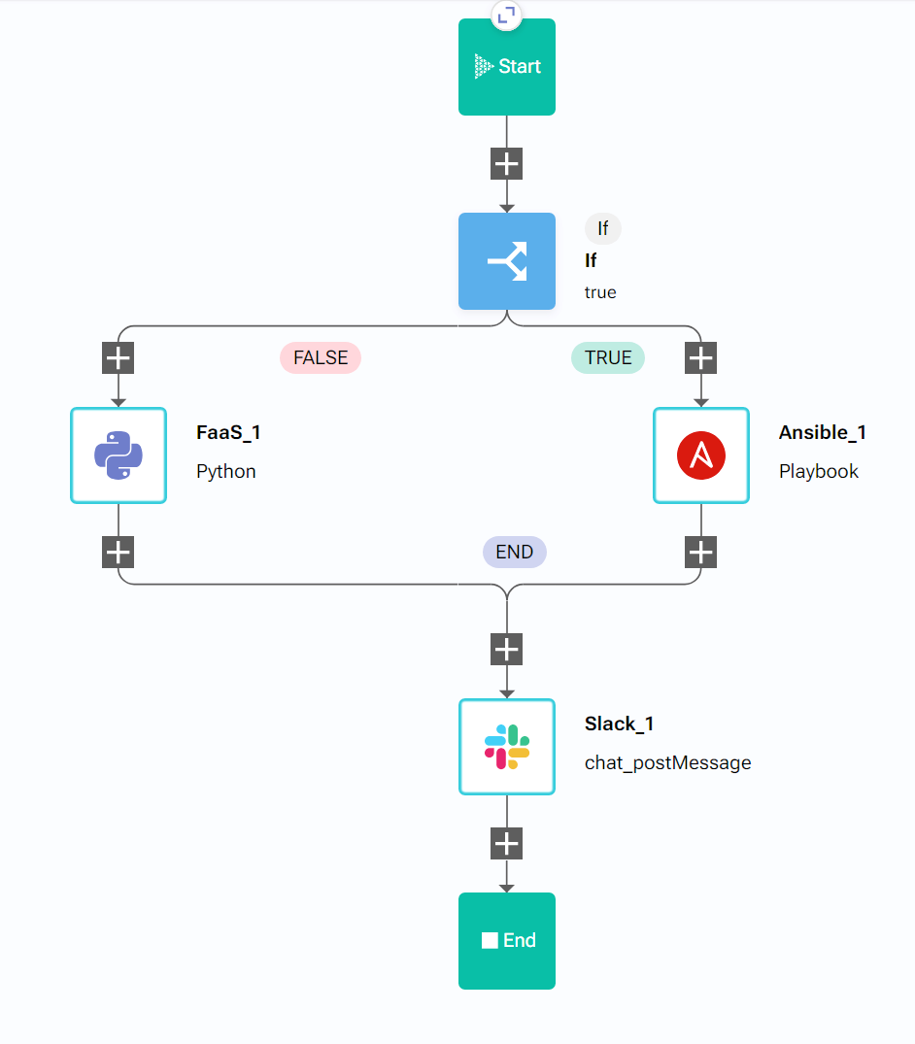
IBM Concert Workflows
The tool for large scale, cross-team, cross domain automation and orchestration.
Features
Low-code IT orchestration
Amplify existing automation
Consumable automation
Enable event-driven automation for any platform
Preserve existing automation investment
Automate, Integrate, Connect across:
☑ Applications ☑ Security ☑ Automation ☑ Infrastructure ☑ Performance ☑ Cloud ☑ ITSM
Notes:
The final component is Concert Workflows.
Workflows is designed for large-scale, cross-team and cross-domain automation and orchestration.
Most organizations already have automation in place. The challenge is that those automations often live inside individual tools or teams and still require people to coordinate the handoffs between them.
Concert Workflows helps connect those existing investments into broader operational processes.
It provides low-code orchestration, supports event-driven automation, and helps teams create reusable automation that can span applications, security, infrastructure, cloud, performance, ITSM, and other operational domains.
Just as importantly, Workflows is not about forcing customers to replace the automation they already have. It can amplify and coordinate existing tools and processes rather than starting over.
Consider Workflows when customers describe manual handoffs, disconnected automation, repetitive cross-team processes, or difficulty moving from a recommendation to coordinated execution.
Workflows helps turn decisions into repeatable, governed action across the operational environment.

Slide 10





From Portfolio Understanding to Customer Application
Now that you understand how IBM Concert components map to IBM products, the next step is learning how to apply them in real customer conversations.
Customer Priorities
Use Cases
Start with the operational challenge or business outcome the customer needs to achieve
Map the priority to representative scenarios IBM Concert addresses
Stakeholders
Outcomes
Identify the right personas and decision-makers involved
Connect to the IBM Concert components and products that deliver results
Key takeaway: Lead with the customer need, then connect it to the right IBM Concert components and products.
Notes:
We’ve now moved from the IBM Concert platform story to the six components, the products behind them, and the role each plays.
But knowing the portfolio is only part of the job.
Customers rarely begin by saying, “I need Observe,” “I need Optimize,” or “I need Turbonomic.” They usually begin with an operational challenge or an outcome they need to achieve.
That is why the next step is to shift from the portfolio view to the customer view.
We start with the customer priority: what problem are they actually trying to solve?
From there, we connect that priority to representative use cases, identify the stakeholders involved, understand the outcomes they care about, and then determine which IBM Concert components and products are most relevant.
The key takeaway is simple: know the portfolio, but lead with the customer need.
In the next module, we’ll put that approach into practice by exploring the most common customer priorities IBM Concert helps address.

